Slide 1
Memento Pattern - Behavioral
A reminder of past events

Slide 2
Definition
Without violating encapsulation, capture and externalize an object’s internal state so that the object can be restored to this state later.

Slide 3
Memento pattern
memento: a saved "snapshot" of the state of an object or objects for possible later use; useful for:
  writing an Undo / Redo operation
  ensuring consistent state in a network
  persistency; save / load state between executions of program

Slide 4
Applicability
Use the Memento pattern when:
  A snapshot of an object’s state must be saved so that it can be restore to that state later, and
  A direct interface to obtaining the state would expose implementation details and break the object’s encapsulation

Slide 5
Participants
There are 3 participants in the Memento pattern:
  Originator: whose state has to be maintained
  Memento: stores the state of the Originator object
  Caretaker: has a handle to the Memento

Slide 6
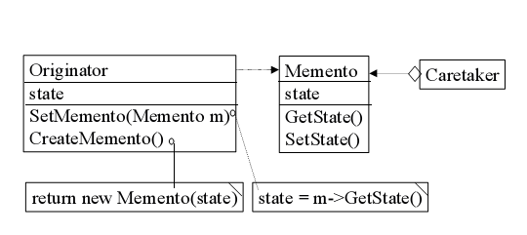
Structure

Slide 7
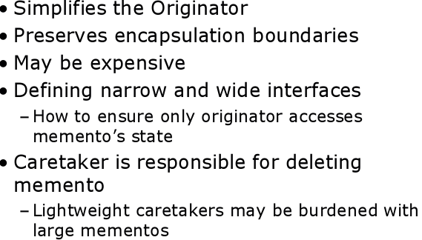
Consequences of using Memento

Slide 8
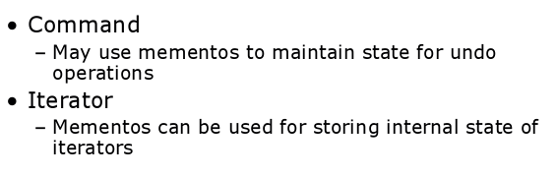
Memento Vs other patterns

Slide 9
Java program illustrates the "undo" usage of the Memento Pattern.
import java.util.List;
import java.util.ArrayList;
class Originator {
private String state; // The class could also contain additional data that is not part of the state saved in the memento.
public void set(String state) {
System.out.println("Originator: Setting state to " + state);
this.state = state;
}
public Memento saveToMemento() {
System.out.println("Originator: Saving to Memento.");
return new Memento(state);
}

Slide 10
Java program illustrates the "undo" usage of the Memento Pattern.
public void restoreFromMemento(Memento memento) {
state = memento.getSavedState(); System.out.println("Originator: State after restoring from Memento: " + state);
}
public static class Memento {
private final String state;
private Memento(String stateToSave) {
state = stateToSave;
}
private String getSavedState() {
return state;
}
}
}

Slide 11
Java program illustrates the "undo" usage of the Memento Pattern.
class Caretaker {
public static void main(String[] args) { List<Originator.Memento> savedStates = new ArrayList<Originator.Memento>();
Originator originator = new Originator(); originator.set("State1");
originator.set("State2");
savedStates.add(originator.saveToMemento());
originator.set("State3");
// We can request multiple mementos, and choose which one to roll back to.
savedStates.add(originator.saveToMemento());
originator.set("State4");
originator.restoreFromMemento(savedStates.get(1));
}
}

Slide 12
Output
Originator: Setting state to State1
Originator: Setting state to State2
Originator: Saving to Memento.
Originator: Setting state to State3
Originator: Saving to Memento.
Originator: Setting state to State4
Originator: State after restoring from Memento: State3

Slide 13
Another Example
Suppose you have a an object which stores form information and you would like to allow the user to make changes in the form and then if they make a mistake later you can put back in the original form values.
  Well, you could serialize the form object and then un-serialize it later but this is obviously messy and not a good solution.
  Another possible solution would be to have an outside object use the form's accessors methods to pull out what you need to save the state but this causes high coupling between the class saving the state and the form; any changes in the form would require changes in the other class.
  We need something that will allow you to save the state and restore it later without having to get involved in the details. This is where the memento pattern comes in.

Slide 14
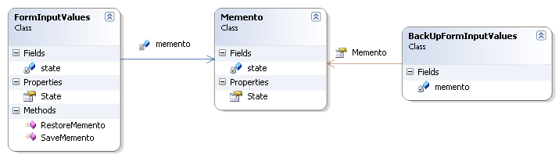
Another Example

Slide 15
Non-Software Example - Do-it-yourself mechanics repairing drum brakes on their cars.
The drums are removed from both sides, exposing both the right and left brakes.
Only one side is disassembled, and the other side serves as a Memento of how the brake parts fit together.
Only after the job has been completed on one side is the other side disassembled.
When the second side is disassembled, the first side acts as the Memento.

Slide 16
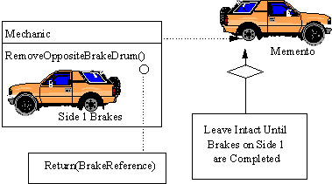
Non-Software Example - Do-it-yourself mechanics repairing drum brakes on their cars.

